Slide 1
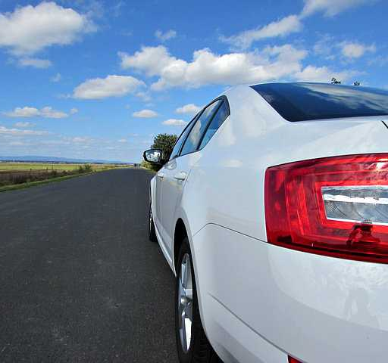
2019 Car Rental Planning
By Rachelle Tsao
This Photo by Unknown Author is licensed under CC BY-NC-ND
Notes:
Hello my name is Rachelle Tsao,
I have a background working in the travel industry and I see that car rentals play a big part in travels.
Today I wanted to focus on how we grow the company in 2019

Slide 2
2018 baseline revenue 2019 Goal increase Revenue
Notes:
Here you see in the graph the baseline revenue for 2018.
And for the next year I would like to increase both revenue.
How will we reach that goal?

Slide 3
Strategy 1 Remove low performing car inventory
Sell 50 least profitable models
Notes:
First Strategy
is to remove 50 of the lowest performing cars currently in our inventory across all branches.
This would help cut back on the loss and we can even consider selling those 50.
With this strategy we are able to save a little bit more on profit. ($80,000)

Slide 4
Strategy 2 Increase High performing car inventory
Add 10 more cars to 50 most profitable models
Notes:
Second strategy option is to increase the inventory on our top 50 performing cars.
by adding 10 more to each model at the branches it performs well at.

Slide 5
Strategy combine Combine Strategies 1 & 2
Notes:
3rd strategy would be to combine both strategy 1 & 2 in order to raise our revenue.

Slide 6
Recommended Strategy Combine Strategies 1 & 2
19% growth rev
31% profit
Notes:
I recommend combining both strategies because it would help us increase our revenue by 19%.

